Slide 1
Fully content-based movie recommender system with feature extraction using neural network Hung-Wei Chen ; Yi-Leh Wu ; Maw-Kae Hor ; Cheng-Yuan Tang ICMLC 2017, Ningbo, China
報告者：陳克威
日 期：2019/10/18

Slide 2
Outline
Introduction
Word2Vec Model
Proposed Method
Experiments
Conclusions

Slide 3
Introduction

Slide 4
Motivation
Collaborative filtering (CF) methods suffer from the cold-start problem.
We propose ”FCMR” method. (Fully content-based movie recommender system)
Using Word2Vec CBOW to extract feature vectors.
DataSet : Movielens-20M

Slide 5
Related Work
Collaborative Filtering (CF)
[6] An algorithmic framework for performing collaborative filtering
[7] Item-based collaborative filtering recommendation algorithms
[8] Explaining collaborative filtering recommendations
[9] Matrix factorization techniques for recommender systems

Slide 6
Related Work
Content-based method (CB)
[10] Jointly modeling aspects ratings and sentiments for movie recommendation
[11] Content-based movie recommendation using different feature sets

Slide 7
Contributions
1. Fully content-based : no user browsing history is necessary while training models.
2. First method to use the Word2Vec CBOW model.

Slide 8
Word2Vec Model

Slide 9
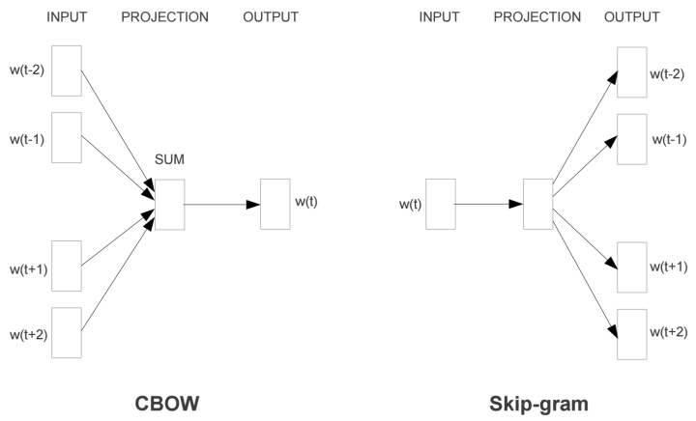
Word2Vec
The Similarity between words can be measured easily by calculating the cosine distance between two word vectors.
The extracted features can keep the semantically linear relationship between the original words.
Notes:
semantically = 語義上

Slide 10
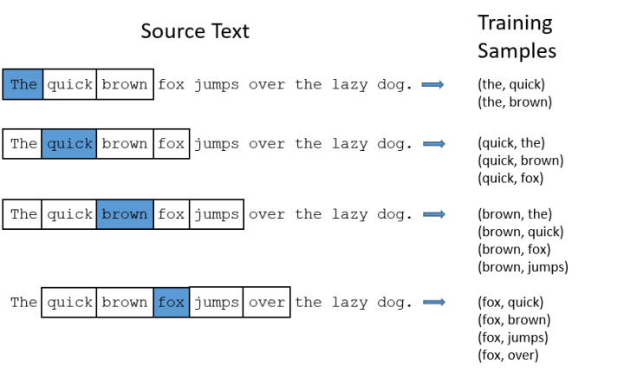
Word2Vec
The Similarity between words can be measured easily by calculating the cosine distance between two word vectors.
The extracted features can keep the semantically linear relationship between the original words.
Notes:
semantically = 語義上

Slide 11
Proposed Method

Slide 12
Dataset and Preprocessing
DataSet : MovieLens-20M (27K movies, 138K users, and 20M ratings.)
Content : we retrieve about 23K movies' data from the IMDb through the APIs. (OMDb)

Slide 13
Proposed Method
To generate a dataset which Word2Vec model can use as input, the movie data must be represented in sentence form.
We treat part of the movie metadata as words and compose them into a movie sentence that can describe the movie itself.
In the end, we denote this collection of movie sentence as “Movie Sentence Dataset” in the following paragraphs.

Slide 14
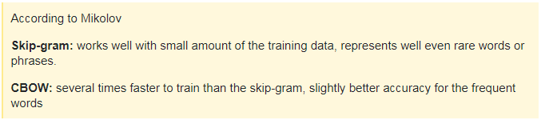
Feature Extraction
CBOW > Skip-gram : we conjecture predicting the current word (e.g., an actor) based on its context (all the other words in the movie sentence) is more reasonable and simpler than predicting the surrounding words given the current word.
Furthermore, our dataset, the Weighted Movie Sentence Dataset, is much smaller than the dataset used in [1]. We are not sure if the Skip-gram model will work with relatively small dataset. Therefore, we choose the CBOW model to extract feature in our proposed method.
Notes:
1.根據上下文來預測當前文字會比較合理 (surrounding = 周圍)

Slide 15
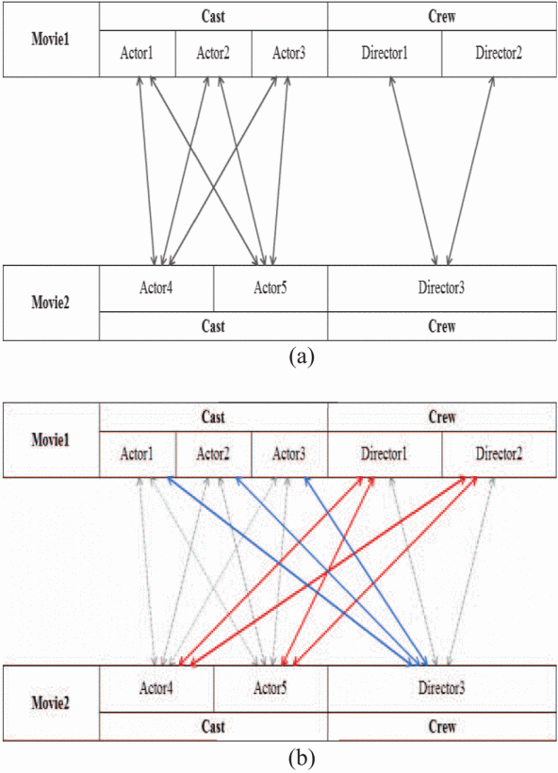
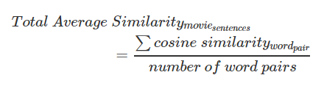
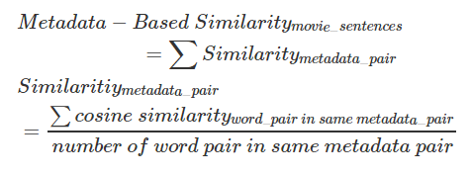
Similarity Measurement

Slide 16

Recommendation List Generation

Slide 17
Experiments

Slide 18

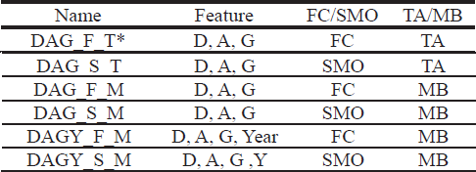
Experiments
Two different ways to calculate similarity, the Fully-Connected (FC) and the Same Metadata Only (SMO)
Two different ways to average the similarity, the Total Average (TA) and the Metadata-Based (MB)
Different feature sets are also considered.
Notes:
Director, Actor, Genre

Slide 19
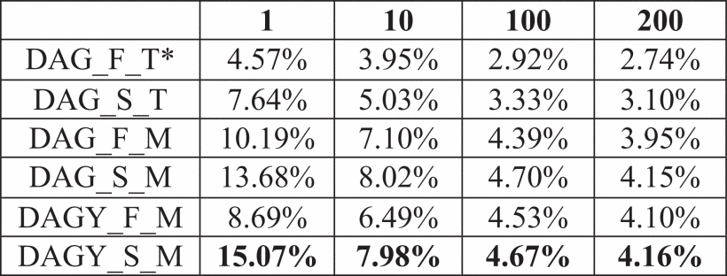
Experiments
Notes:
Director, Actor, Genre

Slide 20
Conclusions

Slide 21
Conclusions
We will try to treat the browsing history of a user as a sentence and use the sentences to train a word2vec model. Last but not least, combining the CF and the Content-based method into a hybrid model is a promising way to improve the performance.

Slide 22
Thanks for listening.
報告者：陳克威
日 期：2019/10/18

